Slide 1
Warm Up #1
What does it mean for an energy source to be “renewable?”
Give two examples of energy sources that are “renewable.”
Do you think “renewable” sources like the two you listed are good or bad? Explain.

Slide 2
Warm Up #2
Where have you seen the word “watts” being used before? What do you think it means?
How can you tell a car, like a Acura NSX, is powerful? (i.e. what quality about the car makes it powerful?)
How many meters are in a kilometer? What about a megameter (yes, that’s a real thing)?

Slide 3
Chapters 15 & 16
Energy: Renewable and Non-Renewable

Slide 4
Laws of Energy (Thermodynamics)
Law 1: Energy cannot be created or destroyed
  You can’t make something out of nothing
Law 2: When energy is converted from one form to another, some of that energy is lost
  Moving up food chain, some energy lost as HEAT

Slide 5
Measuring Energy: Watts
Watt – standard unit of measurement for energy
Two forms you will see:
Kilowatts (1 kW = 1000 watts)
  1x10³ watts
Megawatts (1 MW = 1,000,000 watts)
  1x10⁶ watts

Slide 6
Other Forms of Energy: Part 1
Horsepower (HP) - measures the power generated by horses (original definition)
  Ex. 1 horsepower = power of 1 horse
Conversion:
1 HP = 746 watts
  Random, I know. Sorry about it.
Ferrari vs. Prius

Slide 7
Other Forms of Energy: Part 2
British Thermal Units (Btu) – Amount of energy needed to raise 1 lb. of water by 1ºF
  Think of it like a calorie (food)
Random Conversions:
1 watt = 3.4 Btu
1 HP = 2,540 Btu

Slide 8
Kilowatt Hours & Your Electric Bill
Your electric bill – measures amount of power used over a period of time
You will see: Kilowatt Hours (kWh) – amount of watts generated in 1 hour
  Kilowatts x hours = kWh
For these conversions:
Know what you are starting with
Know what they are asking for
Convert accordingly

Slide 9
Quick Quiz # 1
A resident of Beverly Hills, a community of 10,000 homes, uses on average about 5,000 kilowatt hours of electricity per year. The cost of electricity in this community is $0.20 per kWh.
How much electricity would a resident use in a 20 year period?
How many kWh of electricity does all of Beverly Hills use in one year?
What would their electric bill be as a community for one day?

Slide 10
Warm Up # 3
A wind turbine in Palm Springs, a community with 800 turbines, uses on average about 10,000 kilowatt hours of electricity per year. The cost of electricity in this community is $0.20 per kWh.
Calculate the amount of energy generated from 1 turbine in 15 years.
Calculate the amount of energy generated by all of the wind turbines in 1 day
For this day, how much would it cost the people of Palm Springs

Slide 11
Warm Up #4
You live in a community of 3,000 homes that rely on coal as a source of fuel. The average home uses 8,000 kwh of energy per year at the cost of $.10/kwh.
Instead, town members want to switch to wind power; installing 10 wind turbines ($3 million each) which will last 25 years.
List two pros and two cons for switching to wind power.
How much energy does your entire community use per year?
If the energy needs stay the same over the 25 year lifetime of the wind turbines, what would be the cost for the community for wind power (in $/kwh)? How does it compare to the cost of coal?

Slide 12
Warm Up #5
Describe what biomass is, and why biomass, a renewable resource, could also be considered nonrenewable.
Why is coal an ideal source of power, and what are its drawbacks?
You have a lot of nuclear waste…gross. What do you do to get rid of it? Why do you think this method is best?

Slide 13
Non-Renewable Energy

Slide 14


Remember: Laws of Energy/Thermodynamics
Law 1: Energy cannot be created or destroyed
  Can’t make something out of nothing, can’t make something disappear
Law 2: When converted from one form to another, some energy lost as heat
  Energy generated = NET ENERGY
    Ex. your paycheck AFTER taxes (taxes = heat)
“I LOVE LOSING $1,000 OF MY PAYCHECK TO TAXES!!!!!!!”

Slide 15
Forms
Coal – most abundant, dirtiest, most energy-efficient
  Most is in China (75%), large % in US (last 300-1000 years)
Oil – most versatile, most popular
  Gas, plastics, cosmetics, etc. (last only 25 years)
Natural Gas – cleanest fossil fuel
  Gateway from nonrenewable to renewable
Nuclear – most powerful, most unstable
  10 million times more powerful than F.F.

Slide 16

Nonrenewable and Sustainability
Every energy source is renewable (technically)
Sustainability – living within your means
  Not using too much
Fossil Fuels – take 10,000+ years to form
“the thousands of dollars I spent on hair products sent me into debt…but at least I look like an authentic homeless person!”

Slide 17
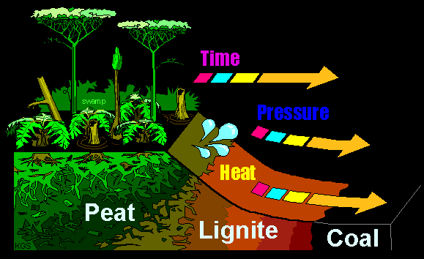
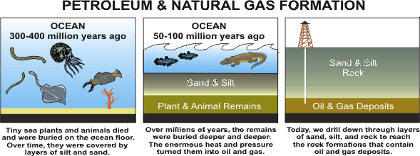
How Do Fossil Fuels Form?
Coal – dead plants in swampy biomes
  trapped in water-logged soil
  Over time, soil hardens and coal forms
Oil & Natural Gas – dead marine organisms
  High pressure, oxygen-free ocean floor = oil & gas

Slide 18
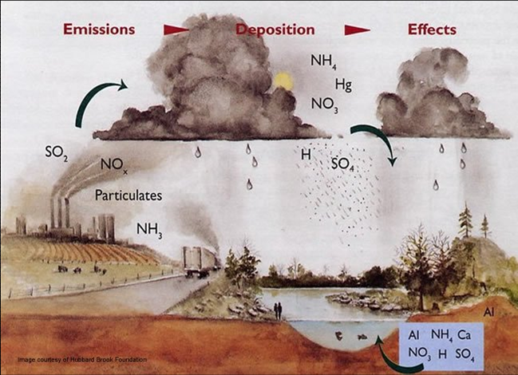
The Problem with Coal: Acid Rain
Coal = mined (China, Eastern US)
When burned, releases sulfur-based gases
H₂SO₄ (sulfuric acid) – lowers pH of rain
Surface runoff – pollutes water

Slide 19
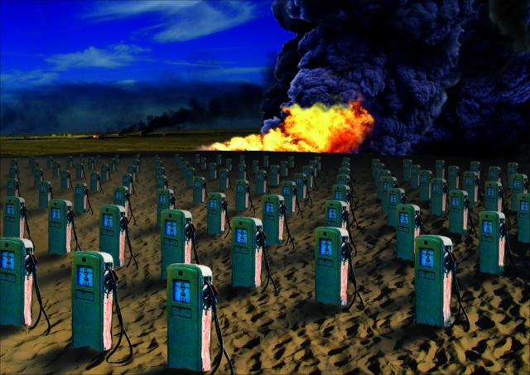
The Problem with Oil: Scarcity
25 years – we will run out of oil
Too many uses (plastics, gas, etc)
Political turmoil (Middle East)
  70% oil = imported
The price of oil?

Slide 20
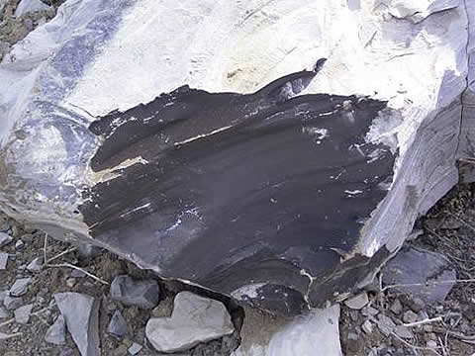
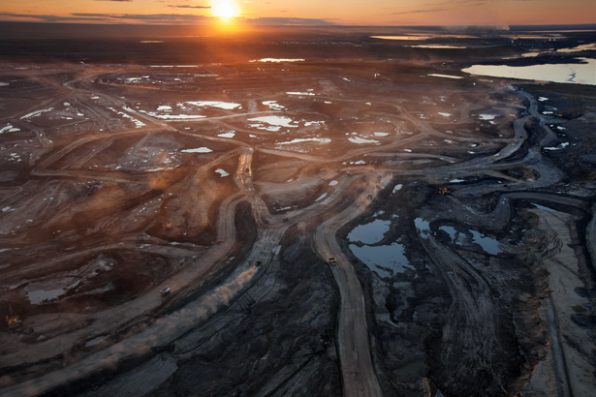
Another Natural Gas Hybrid: SynFuels
Liquefaction – turning rocks into liquid for fuel
Shale Oil – oil from a certain rock (kerogen)
Tar Sands – oil from tar (bitumen)
Problem: not energy efficient

Slide 21
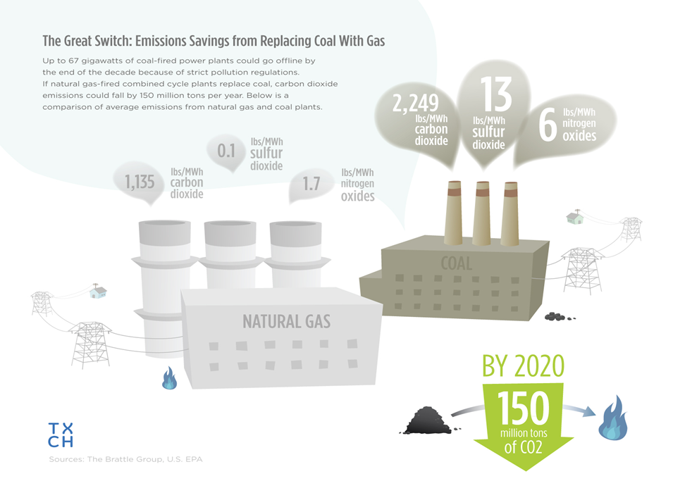
Natural Gas:
A Clean Gateway into the Future

Slide 22
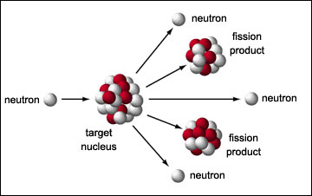
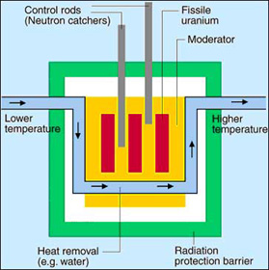
How Nuclear Power Works
Nuclear Fission – neutron collides into uranium (U), causing U to split, creating energy
Energy → Heat & steam
Steam → Turbines → power
(25-30% efficient)

Slide 23
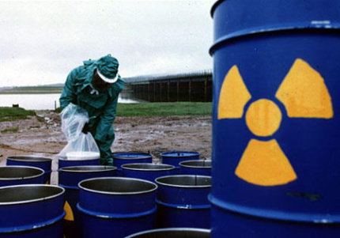
Options for Radioactive Waste Disposal
Bury It – could seep into soil (Love Canal)
Into Space – expensive & risky
Under Ice Sheets – could melt them (less albedo)
Oceans - contamination

Slide 24
Non-Renewable Energy Commonalities
Most popular/most available
Relatively LOW net energy yield
High costs overall
High environmental impact

Slide 25
Quick Quiz # 2
How is coal formed? Where does it tend to be found?
Give one example of a SynFuel, and why it is a good idea. What is one of the drawbacks of a synfuel?
Why is it so difficult to get rid of nuclear waste? Which method of nuclear waste disposal do you think is the best? Why?

Slide 26
Warm Up #6
Why can it be said that, technically, all forms of energy can be considered renewable?
Give two reasons why solar power has not grown popular yet in America.
What do you think it means to be efficient? What about energy efficient?

Slide 27
Renewable Energy

Slide 28


With Rising Gas Prices…Create your Own Fuel!
Biofuel – energy produced from organic matter
  Vegetable oil, corn oil, etc.
  Microalgae = miracle bacteria
Diesel to BioDiesel converter
Gas = $1.25/gallon
Reduces G.H. gases

Slide 29
Renewable Energy Types
Solar – most energy efficient
Wind – fastest growing energy source, noise pollution
Biomass – developing countries, deforestation, soil erosion
  Sustainability issues
Hydroelectric – dams (heart attack), most $$ to build
Hydrogen Fuel – works like battery, water = product
Geothermal – using magma for energy, most dangerous

Slide 30
Renewable Energy Commonalities
Expensive to set up, cheap to run
Little to no air pollution/environmental impact
High NET energy (energy after heat released)
Future energy source

Slide 31
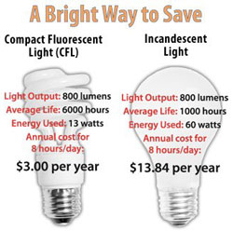
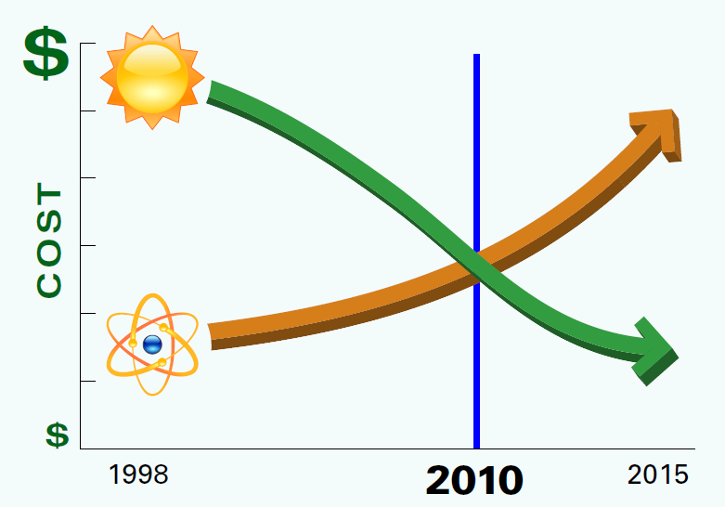
Energy Efficiency & Lights
Paycheck: gross pay (total) vs. net pay (after tax)
Energy Efficiency – how much of gross energy can generate useful energy
  More efficient = less heat lost
Incandescent Light (5% efficient) vs. Fluorescent Lights (22% efficient)
Nuclear (14%) vs. Solar (90%)

Slide 32
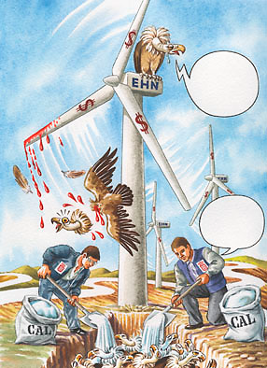
Wind and Noise Pollution
Noise Pollution – excessive, enviro. harmful noise
Turbines kill birds
Steady winds required

Slide 33

Solar: Passive (90%) vs. Active (35%)
Solar – uses sun for energy
Passive – traps sunlight directly for energy
  Greenhouse, windows
Active – solar panels
  Capture sunlight, connected to generator, creating power
Passive House: “I’m do nothing and get all the energy. Lazy is the way to go.”
Active House: “Screw you! I work my butt off and get no energy benefits!”

Slide 34
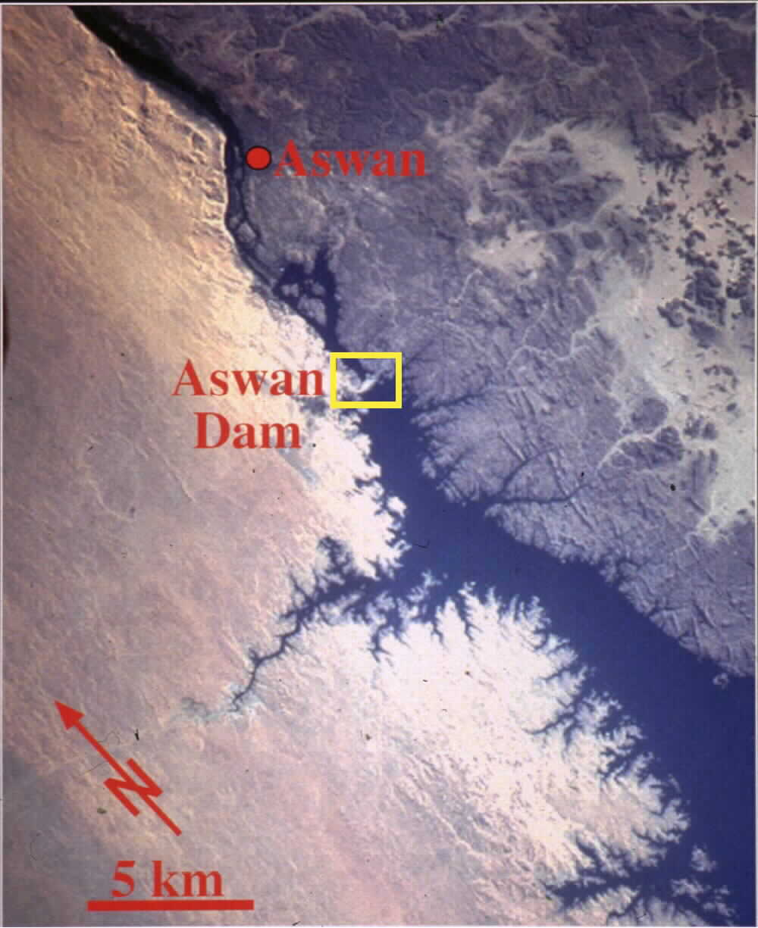
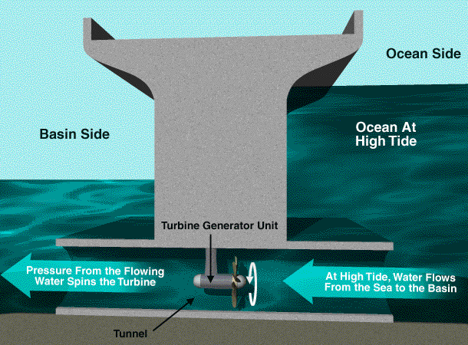
Hydroelectric Chaos:
Aswan Dam & Tidal Waves
Hydroelectric – water spins turbines → power
Aswan Dam (Egypt)
  Erosion, flooding, expensive
Tidal Energy – using the tides to generate energy
  No pollution
  Expensive and kills fish

Slide 35
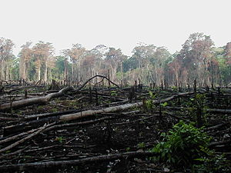
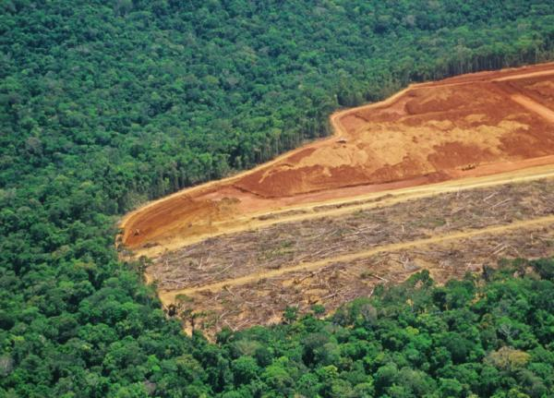
Biomass: Save the Trees, Man
Biomass – burning organic matter (trees, manure, etc)
Developing countries use it
Large scale = deforestation
  Amazon Rainforest
Soil quality (acidic) and erosion
Enhances global warming

Slide 36
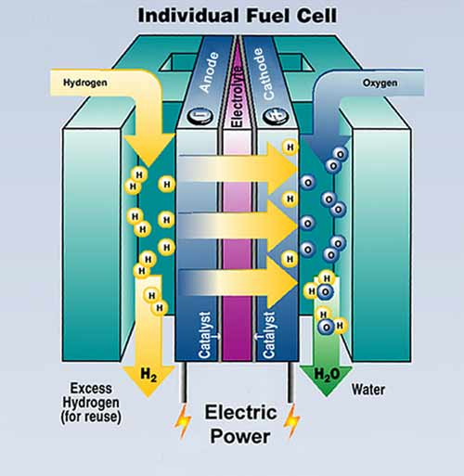
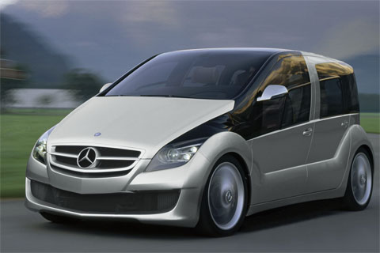
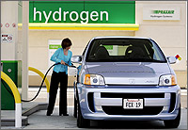
Hydrogen Fuel Cell Cars
Hydrogen Battery – 65% efficient
  Double efficiency of gas engine
Economic risk
  Threat to oil, electric profits
Political struggle
  US oil companies

Slide 37
Warm Up #7

Slide 38
Chapters 15 and 16 Review Slides

Slide 39
Energy
Law 1 = cannot be created or destroyed
Law 2 = energy conversion = heat loss
Gross energy = TOTAL potential energy
Net energy = amount of energy created
  Rest = lost as heat

Slide 40
Energy Units
Watt
  1 kW = 1,000 watts 1kWh = kW x hrs
  1 MW = 1,000,000 watts
Horsepower (HP)
Btu’s = British Thermal Units
  Amt. of energy for 1 lb of H₂O to go up 1ºF
  Calorie

Slide 41
Math Problem
A Hawaiian power plant has the capacity to generate 14 MW of power. The average home in this 4,000 home State uses about 12,000 kWh of electricity per year at the cost of $.12/kwh
Hawaii is planning on setting up a geothermal energy plant to replace their oil dependency. The project will take 20 years and cost $25 million.
Describe how geothermal energy works. What are the drawbacks?
If the power plant works at full capacity for 6,000 hours per year, how many kWh can be produced per year by the plant?
What is the bill of the entire community for 1 year? 20 years? How does it compare to the price of geothermal?

Slide 42
Non-Renewable Energy Commonalities
Take a LONG time to form (F.F.’s = 10,000+ years)
Most popular/most available
Relatively LOW net energy yield
High costs overall
High environmental impact

Slide 43
Non Renewable Energy Types
Coal – most abundant, dirtiest, most energy-efficient
  Most is in China (75%), large % in US (last 300-1000 years)
Oil – most versatile, most popular
  Gas, plastics, cosmetics, etc. (last only 25 years)
Natural Gas – cleanest fossil fuel
  Gateway from nonrenewable to renewable
Nuclear – most powerful, most unstable
  10 million times more powerful than F.F.

Slide 44
Miscellaneous Non Renewable
Fossil Fuels and sustainability (10,000 years to form)
  Oxygen-free, high-pressure environment needed
    Coal – plant matter in swampy biomes
    Oil/Natural Gas – marine matter in former seas
Fossil Fuel Alternatives
  SynFuels (Tar Sands and Oil Shale) - liquefaction
  Biofuel (vegetable oil and economy)
Non Renewables and Pollution
  Coal = acid rain Oil vs. Natural Gas
  Nuclear = radiation (gamma) via fission (disposal = ??)

Slide 45
Renewable Energy Commonalities
Expensive to set up, cheap to run
Little to no air pollution/environmental impact
High NET energy (energy after heat released)
Future energy source

Slide 46
Renewable Energy Types
Solar – most energy efficient
Wind – fastest growing energy source, noise pollution
Biomass – developing countries, deforestation, soil erosion
  Sustainability issues
Hydroelectric – dams (heart attack), most $$ to build
Hydrogen Fuel – works like battery, water = product
Geothermal – using magma for energy, most dangerous

Slide 47
Miscellaneous Renewable
Renewables and Energy Efficiency
  Less effort to convert energy = more efficient
    Fluorescent Light (22%) vs. Incandescent Light (5%)
    Solar (90%) vs. Nuclear (14%)
    Solar – Passive (90%) vs. Active (35%)
    Hydrogen Fuel Cell (65%) vs. Gas Engine (20%)
Renewables and the Environment
  Biomass = deforestation & soil erosion
  Wind = kills birds, noise pollution
  Hydroelectric dams (Aswan) = flooding, salmon

Slide 48
Chapters 7 & 8: Food Webs

Slide 49
Types of Energy
Non-Renewable

Slide 50
Coal
Burned for power (Fossil Fuel)
Mining for coal
Cleaned and either solid or liquid form
China
Northeast US
Pros
A lot of it
Stable, non-explosive
Cheap
Cons
Mining – disrupts land
Releases G.H. Gas
Expensive to transport

Slide 51
Oil
Burned for power (F.F.)
Trapped in porous rocks
Access: drilling
Clean: refineries
Most found in Middle East and Alaska
Pros
Versatile – used for a lot
A lot for immediate future
High energy yield
Cons
Reserves are limited
Produces air pollutants
Political struggles

Slide 52
Natural Gas
Burned for power (F.F)
Found: underground wells (pipelines)
Most in Russia and Middle East
Pros
Easy to transport (pipelines)
Less pollution than F.F.
Transition F.F. from oil
Cons
Disrupts habitats
Leaks CH4 (global warming)
Lower energy yield than oil

Slide 53
Nuclear Energy
Nuclear Fission – split one atom into two others (Uranium)
  Release radiation
Heat → steam → power
Less popular
Chernobyl (nuclear plant meltdown)
Nuclear weapons
Pros (if operated correctly)
10 mill. X energy of F.F’s
Low land disruption
Less CO2 (global warming)
Cons
Malfunctioning
Millions of years to decay
  Half-life
Nuclear war

Slide 54
Types of Energy
Renewable

Slide 55
Hydroelectric Power (Dams)
Dams trap water, which runs through turbines → electricity
3% world’s energy
Hoover Dam
Aswan Dam (bad)
Pros
Control flooding
Cheap to operate
No pollution waste
Cons
Expensive to build
Fish migration destroyed
Destroys rivers

Slide 56
Solar Energy (Sun)
Collecting energy from sun to provide heat/electricity
Solar panels (cells)
Places that are sunny
  California
  Arizona
Pros
Endless energy (sun)
No dependency on others
Can store energy
Cons
Some locations not ideal
Maintenance = expensive
Not energy efficient (15%)

Slide 57
Hydrogen Fuel Cells
Similar to battery
  (-) end = hydrogen
  (+) end = oxygen
Hydrogen passes through to (+) = POWER
Hydrogen cars
United States
Pros
Waste product = water
Source = fresh OR salt H₂O
Fuels cells never run out
Cons
Explosive (H-Bombs)
Gas → hydrogen = $$$
Takes energy to make pure hydrogen

Slide 58
Biomass (Burning Natural Stuff)
Burning natural carbon-based things (wood, manure, etc) for fuel
15% world’s energy
  Developed countries
Places with large forests
  Amazon
  Canada
Pros
Less smog gas produced
No atmos. Disruption
½ world’s demand for electricity
Cons
Needs H2O and fertilizer
Air pollution (burning)
Deforestation (Amazon)

Slide 59
Wind
Wind moves giant turbines to power generators → electricity
Places that are windy and not very populated
  Palm Springs
  North Dakota
Pros
Easy to build
Multiple uses of land
Energy efficient
Cons
Noise pollution
Eye-sore
Steady wind required

Slide 60
Geothermal (Volcanoes)
Use hot steam from magma to drive turbines → electricity
Where: near tectonic plate barriers
  Hawaii
  Japan
Pros
Cheap (similar to F.F.’s)
Energy efficient
Little air pollution
Cons
Waste = destroys ecosystems
Locations = scarce
Noise, odor problems

